Slide 1
Cloud Computing and Internet of Things
CITS5503 Camilo Pestana

Slide 2
IoT
Devices that have the ability to sense the environment, optionally do local processing and communicate to other devices using the Internet
Wide range of hardware, software, communication protocols
Challenges:
  Dealing with potential IoT diversity
  Collecting and integrating large amounts of data
  Security
AWS has a number of products for this – look first of all at AWS IoT

Slide 3
IoT Core
AWS IoT uses MQTT to allow devices to communicate with a Message Broker using MQTT topics
MQTT vs HTTPS
  93x faster throughput
  12x less battery to send
  171x less battery to receive
  50% less power to keep connected
  8x less network overhead
Uses X.509 certificates for authentication and security
Allows for Device Shadows – that store device state
Rules can be created to automatically take messages and put data in a database for example

Slide 4
Message Queuing Telemetry Transport: MQTT
Publish/Subscribe messaging protocol
Publish/Subscribe to topics: hierarchical strings allowing wildcards “this/topic”
Low overhead (2 byte header)
For AWS, can run over TCP with TLS and WebSockets

Slide 5
Connecting a device
Devices can be things like AWS IoT Button
Can run code from various SDKs that run on different platfroms
Registering a device involves:
  Name used as client id
  Assigning it to a group
  Creating or using a root certificate, device certificate and public/private key
  Attaching a policy to the certificate that permissions the device for IoT actions

Slide 6
Using the AWSIoTPythonSDK: Setup
# For certificate based Connection
myMQTTClient = AWSIoTMQTTClient("cits5503-iotdevice1")
# For TLS mutual authentication
myMQTTClient.configureEndpoint("a1oodu4zldtbbf.iot.ap-southeast-2.amazonaws.com", 8883)
myMQTTClient.configureCredentials("root.cert", “private.key", “certificate.crt")
myMQTTClient.configureOfflinePublishQueueing(-1)
myMQTTClient.configureDrainingFrequency(2)
myMQTTClient.configureConnectDisconnectTimeout(10)
myMQTTClient.configureMQTTOperationTimeout(5)

Slide 7
Connect, publish, subscribe
def customCallback(client, userdata, message):
print("Received a new message: %s from topic: %s” % (message.payload, message.topic))
myMQTTClient.connect()
myMQTTClient.subscribe("cits5503/sub", 1, customCallback)
loopCount = 0
while True:
myMQTTClient.publish("cits5503/pub", "test %s" % loopCount, 0)
loopCount += 1
time.sleep(5)
myMQTTClient.unsubscribe("cits5503/pub")
myMQTTClient.disconnect()

Slide 8
Device Shadow Service
An IoT device usually only sends a message when something changes or at predefined times
Applications also may only want the current state and not a history of all of the changes over a period of time
Querying the device directly is harder to do and more expensive in terms of communications
A Device Shadow Service keeps track of state and allows for asynchronous store and forward style communication with IoT devices

Slide 9
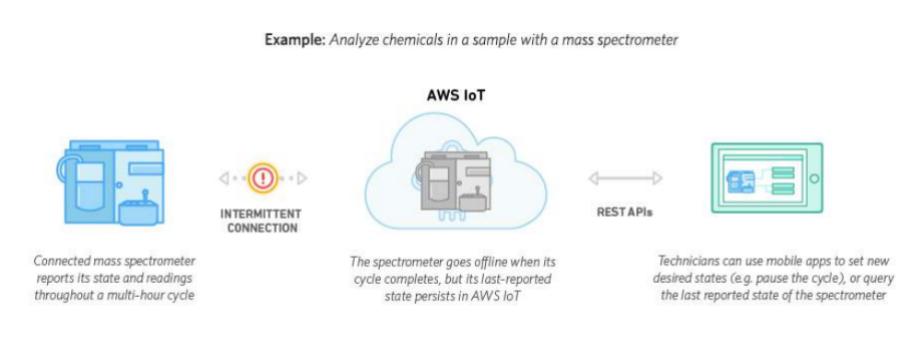
Device Shadow Service Example

Slide 10
Device Shadow Service Flow

Slide 11
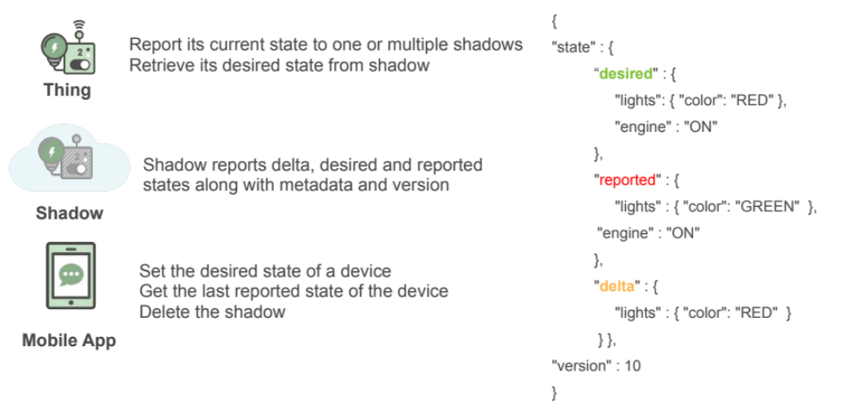
Simple JSON to Communicate Commands

Slide 12
AWS Greengrass
Greengrass allows for the IoT Core to be executed on an edge device
  Server, Raspberry Pi, Other computing device
Supports MQTT communication and Lambda Functions
Can provide OTA updates to devices

Slide 13
Interfacing with Machine Learning

